Slide 1
JobHistory Trends and Coverage
Amanda Rohrer
Notes:
JobHistory table released in October, opportunity to answer some of the questions that have been lingering. What kind of coverage is there? Does the time series align with other sources? How far would I trust this data?
Two approaches – top level and detailed industry comparison

Slide 2
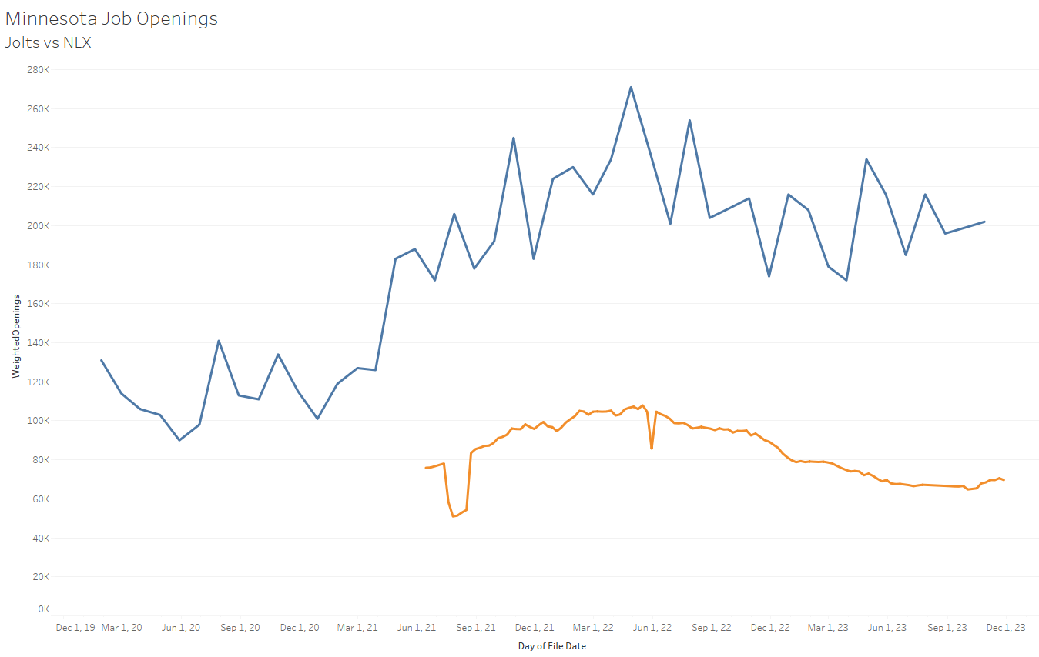
Testing the JobHistory table
Limited to Minnesota to keep scope manageable
Has some correlation with JOLTS

Slide 3
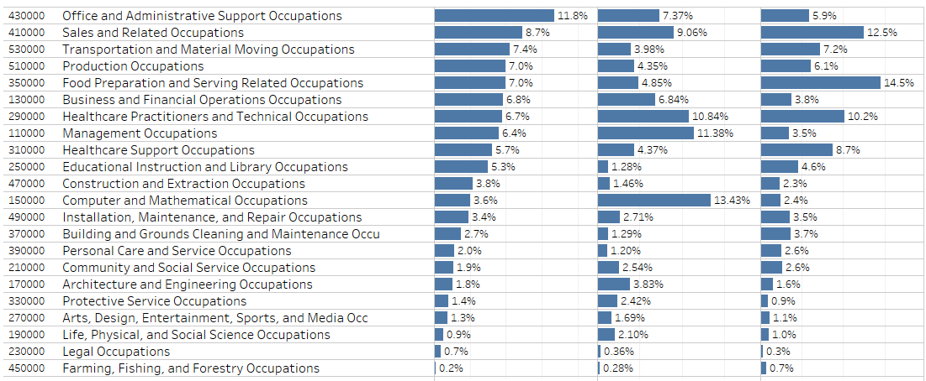
Scope
Distribution of online job postings doesn’t reflect surveyed proportions
Turnover rates
Available labor
Common advertising practices
Size of firms
Where/How widely a job is advertised
Autocoder limitations
That said…take a look at IT jobs
OEWS
NLX
JVS

Slide 4
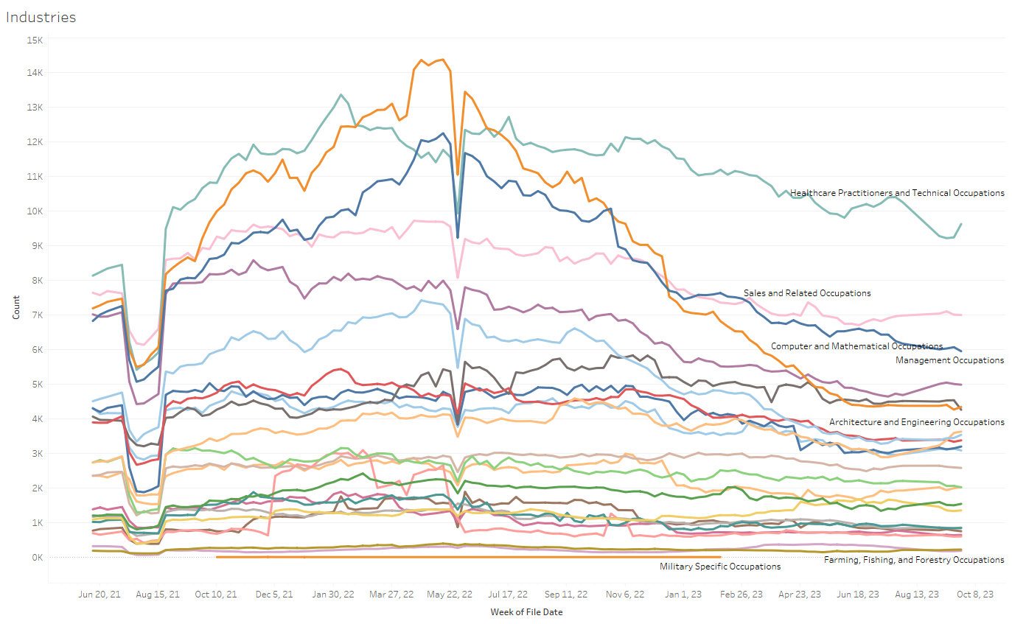
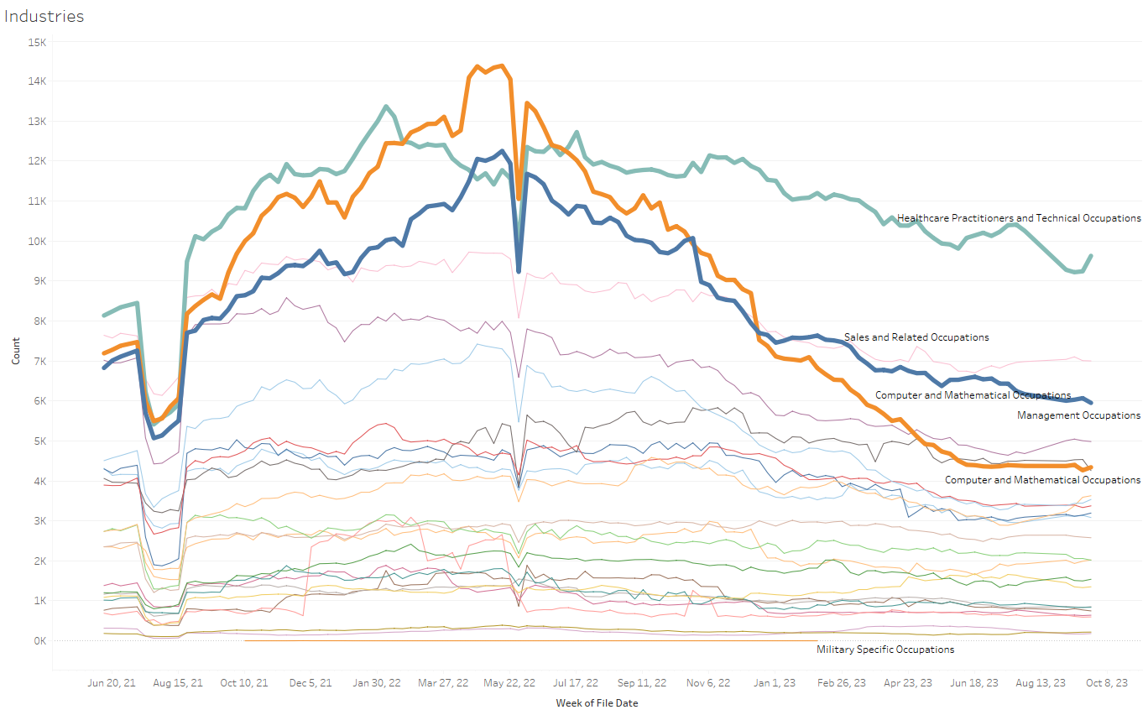
Impact on the Total
Overrepresentation of IT jobs appears to have impacted the trend
Notes:
Decline in IT jobs is consistent with news reports and out of line with trends in other occupations
Persistent hiring difficulties in Health Care is consistent with news reports
Excessive IT representation is pulling the total down
NEXT QUESTION: To weight them in a way that gives a more coherent total, we need to know what the coverage looks like

Slide 5
Next Step: QCEW Coverage
FEIN
Exact name match with Trade or Legal Name
Name completely contained in Trade or Legal Name
  Excluded very short or common names
  Helped to catch differences like LLC or Inc.
Known patterns converted (County of Ramsey > Ramsey County)
Matching occurred both from the QCEW side and from NLX – pool of firms that employed teachers

Slide 6
Narrowing the Scope: Schools
Advantages
Relatively small
Has unique occupations
Inherently local and state-specific
Identifiable economic and seasonal trends
Would have to be heavily reviewed anyhow
 | Total | Matched | Pct Matched
 | 640 | 146 | 22.8%
<50 | 183 | 8 | 4.4%
50-100 | 136 | 24 | 17.6%
100-200 | 160 | 27 | 16.9%
200+ | 161 | 87 | 54.0%
Central | 79 | 21 | 26.6%
NE | 43 | 14 | 32.6%
NW | 112 | 19 | 17.0%
SE | 72 | 14 | 19.4%
SW | 81 | 20 | 24.7%
Twin Cities | 251 | 61 | 24.3%

Slide 7
Aggregate NLX Job Openings by Job Type for Schools

Slide 8
Matched Schools Openings vs JOLTS National Trend
Notes:
JOLTS encompasses all of educational services, not just schools (2/3)
Jobhistory series starts a bit late, but initial increase is consistent with JOLTS, if a little delayed
Seasonal increase in the summer months of QUITS and LAYOFFS, Jobhistory reflects that pattern
Continuing increase in 2023 could be a local variation (anecdotal evidence of staffing shortages)

Slide 9
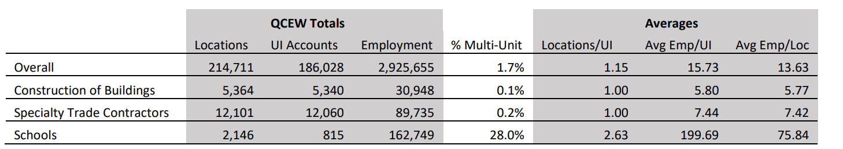
Construction
Construction is made up of much smaller firms than schools
Less stable – more openings/closures, name changes, extremely seasonal employment
Difficult to edit in other surveys (JVS, QCEW)

Slide 10
Identifying Firms
Search terms in the application_company (excavat, egress, window, exterior, paint, cooling, modular, solar, contractor, remodel, concrete, preserv, bath, restor, hvac, build, electri, plumb, construction, interiors, mason, framing , insulat, mechanical, fenc, garage, drywall, floor, erect, gutter, tile, crane, asphalt, basement, granite, siding)
Firms that posted jobs with ONET codes beginning with 47
Best match was search terms

Slide 11
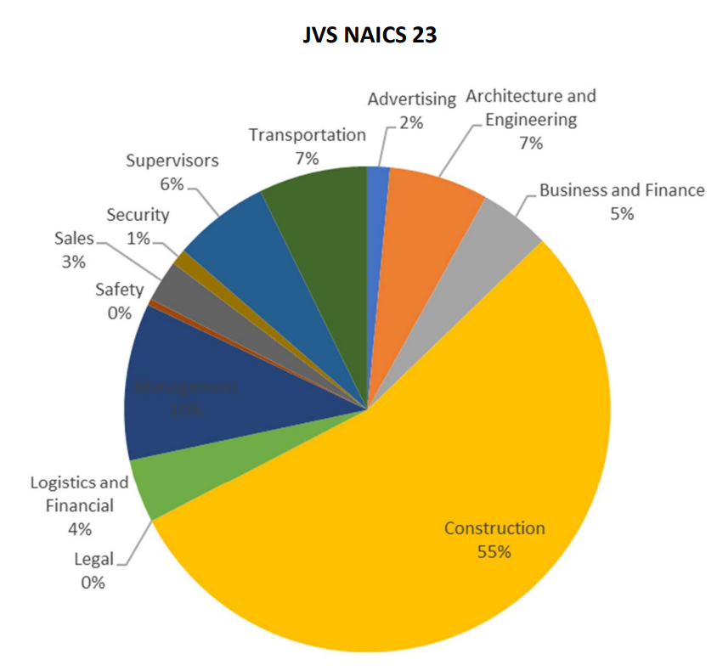
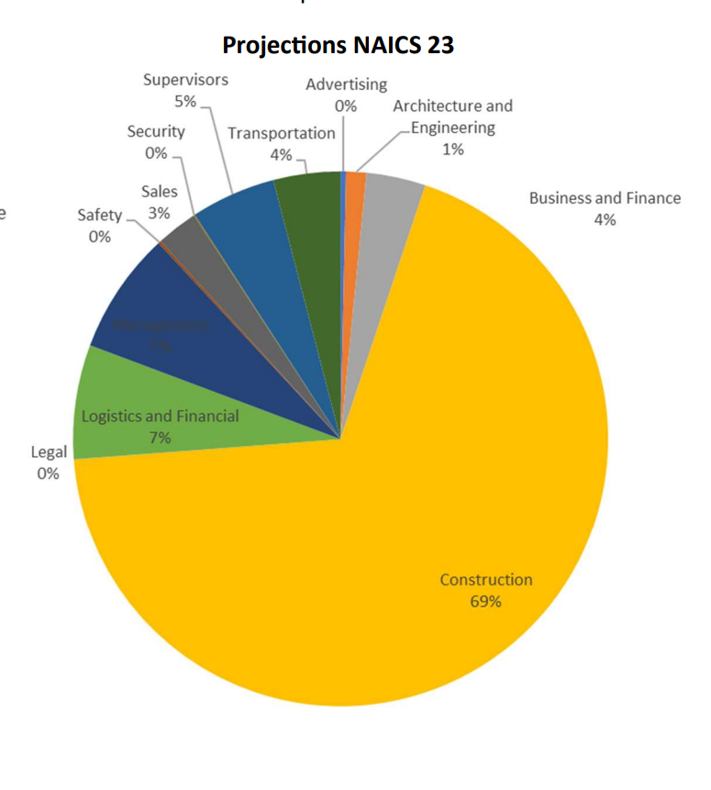
JVS Comparison
Unweighted responses from representative sample with follow-up
Construction jobs are underrepresented
Management and Engineering are most over-represented

Slide 12
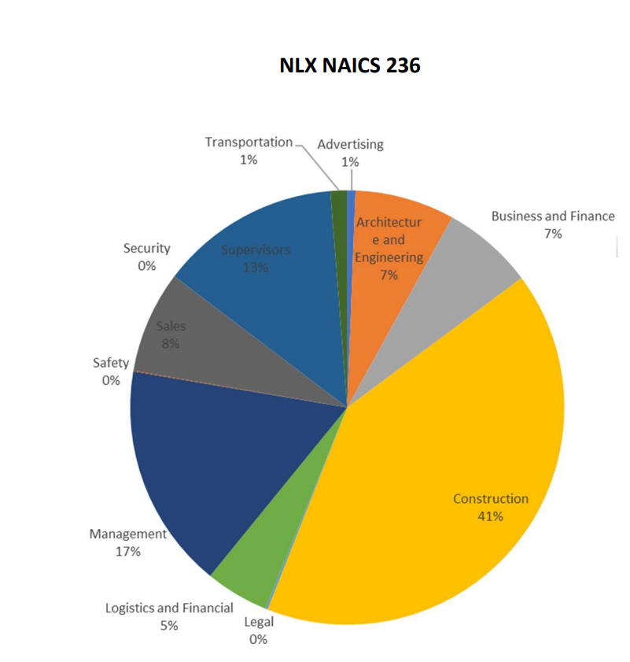
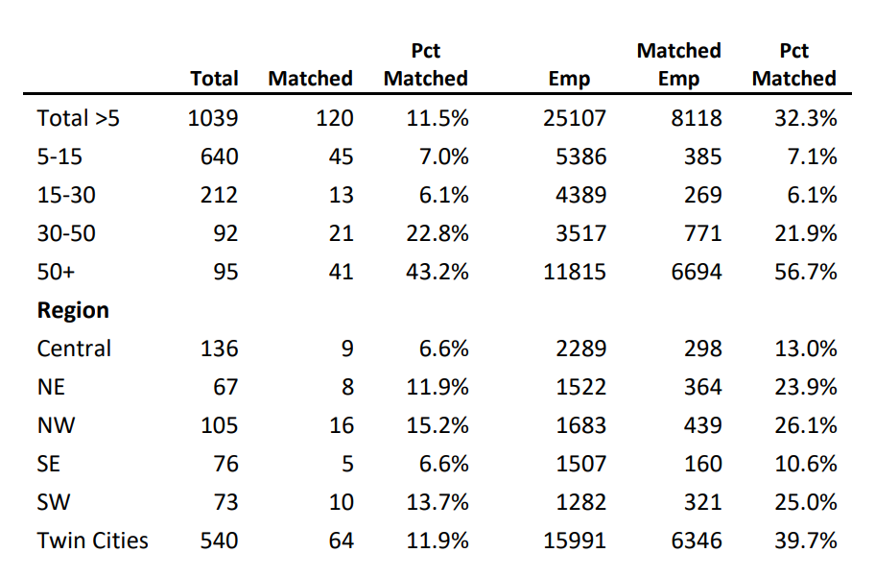
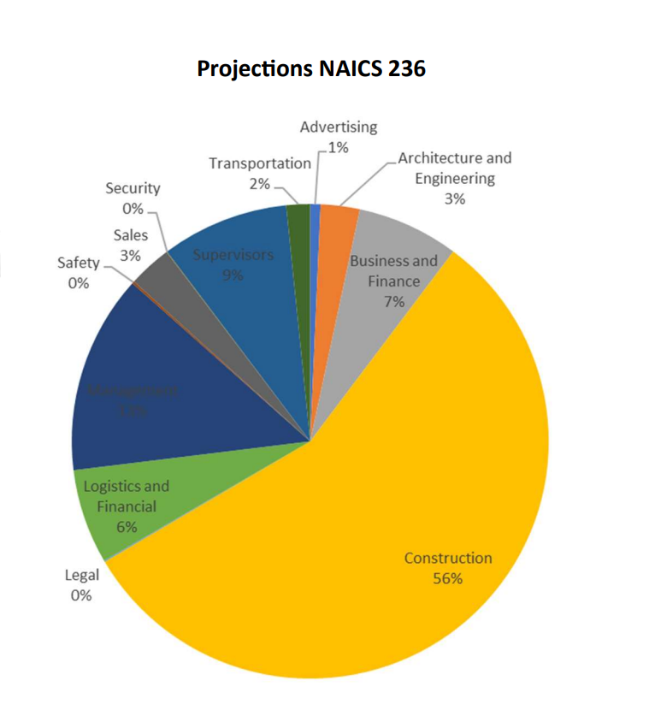
Construction of Buildings

Slide 13
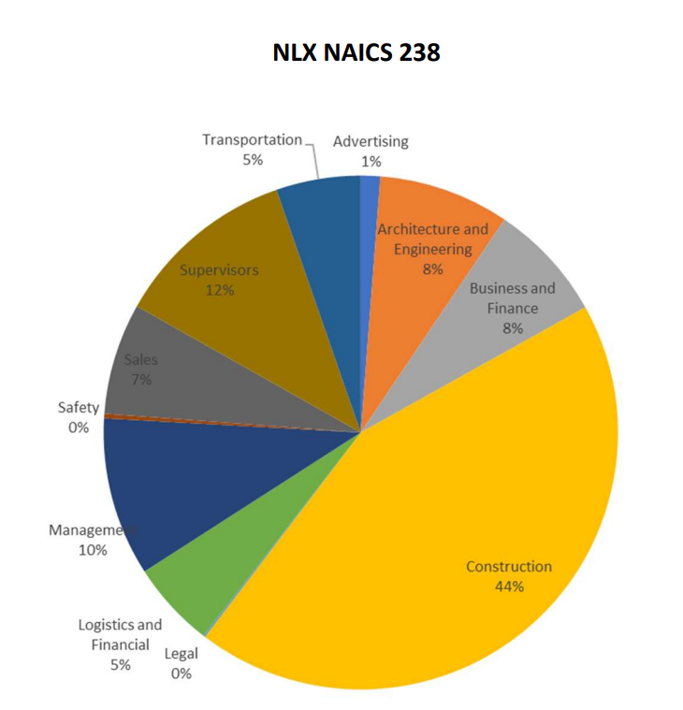
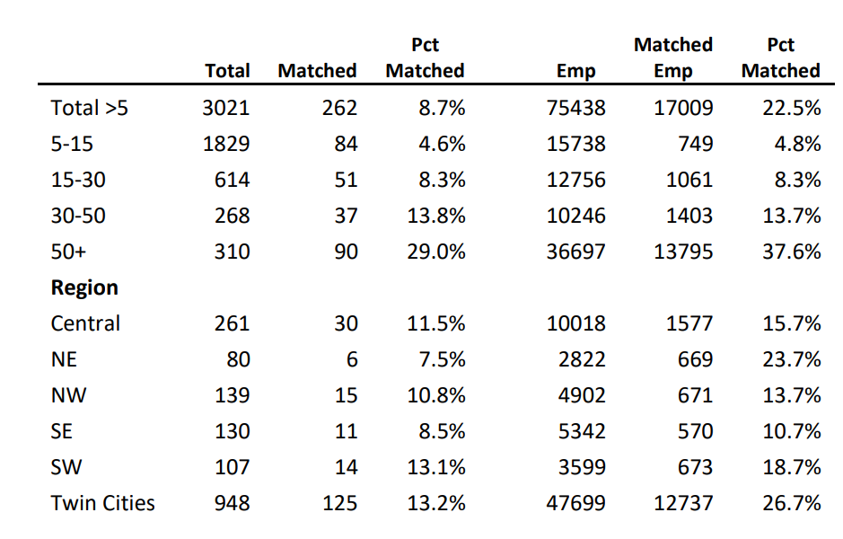
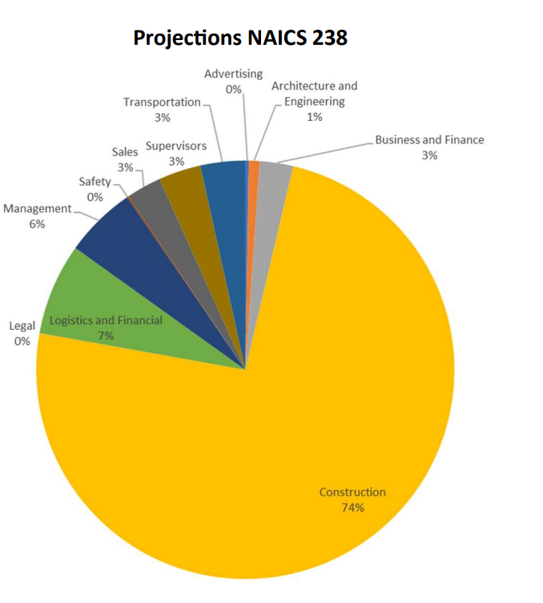
Specialty Trade Contractors

Slide 14
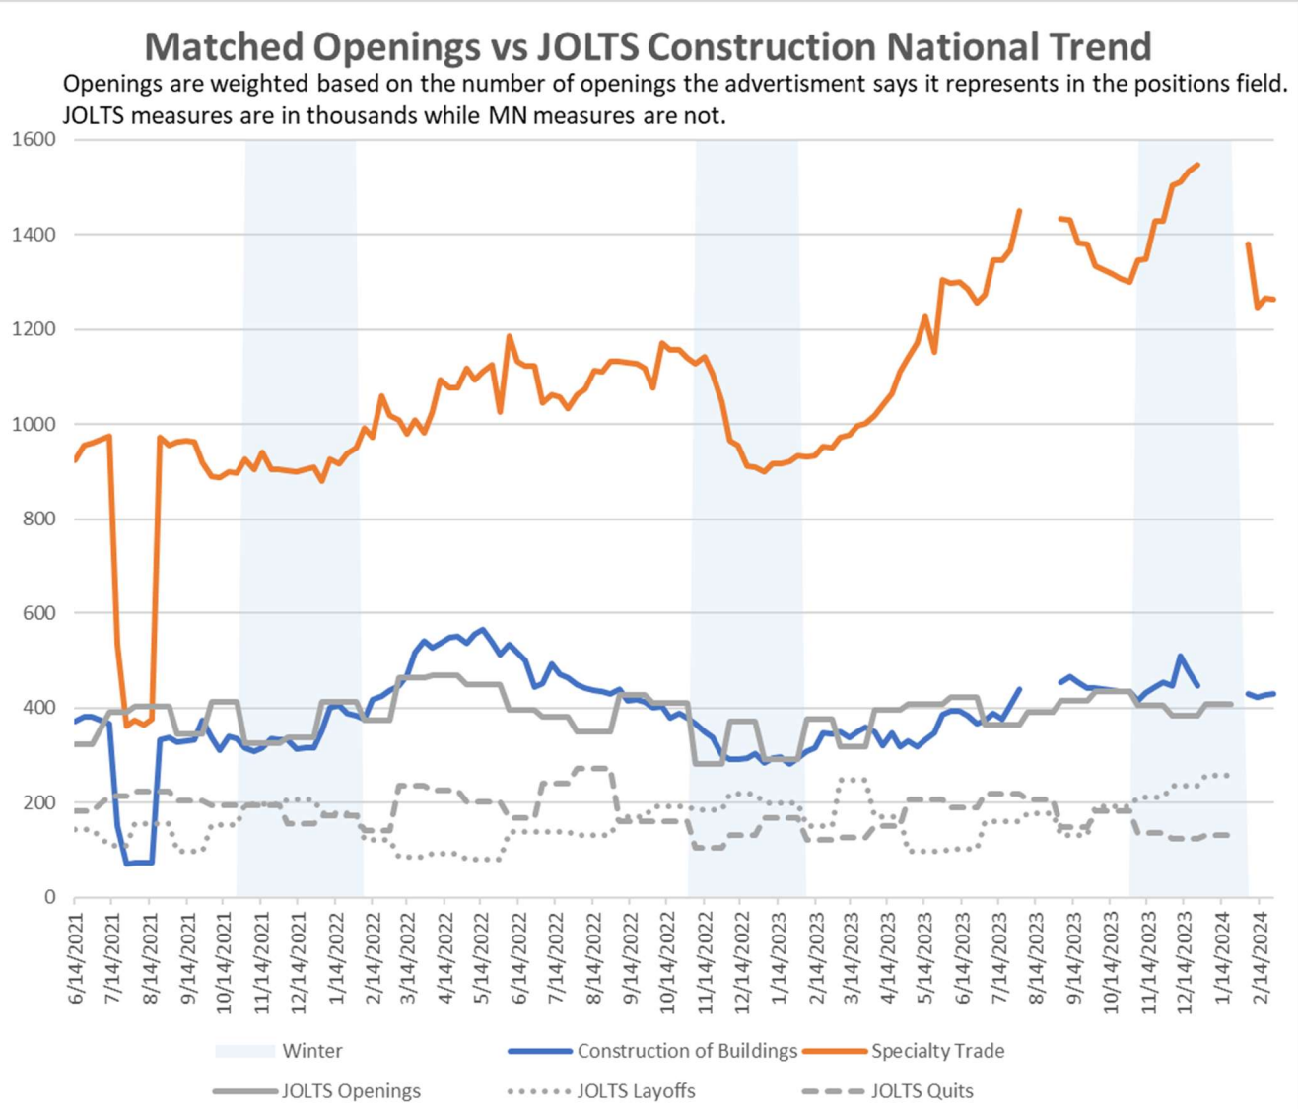
Minnesota Seasonal Trend is likely different than national
Construction of Buildings is fairly consistent with JOLTS
Specialty Trade requires further investigation

Slide 15
Lessons
For some industries, NLX represents a decent sample
  Each industry is different/has different strengths
  NLX advertisers are not homogenous – more small, local firms than expected
Some of the lessons from the matching process could be applied elsewhere
  Use MN matches as training data in a model to help other states match more quickly
  Methods for identifying likely industry from NLX data (keywords in name, occupational hiring)
  Response weights for size and industry (maybe)
  Exclusions of specific firms with unrealistic numbers of openings
  How to treat remote or flexible location openings

